Slide 1
Overview 2018 USDA NIFA AFRI Sustainable Agricultural Systems RFA
Deb Hamernik
Associate Dean, Ag Research
DHamernik2@unl.edu
May 9, 2018

Slide 2
AFRI webinars:
Thursday, May 10, 2018
1:00 pm (central)
https://nifa.usda.gov/event/webinar-afri-sustainable-agricultural-systems-may10
Wednesday, May 23, 2018
2:00 pm (central)
https://nifa.usda.gov/event/webinar-afri-sustainable-agricultural-systems-may23
Will be recorded and archived at: https://nifa.usda.gov/

Slide 3
Submit applications?
or
Submit winning applications!

Slide 4
Be Strategic:
IANR faculty have a competitive advantage for this funding
IANR should not be the lead PD on multiple applications—we should not compete against ourselves
Find opportunities to partner/collaborate on applications led by other institutions, especially MSI, EPSCoR states, etc.
Follow the RFA guidelines—very high expectations for these applications
If you are not on an application, volunteer to serve on the review panel (send CV, COI list, and statement of expertise to AFRI-SAS@nifa.usda.gov)

Slide 5
Purpose of the AFRI SAS RFA:
“Help transform U.S. food and agricultural systems to increase production in sustainable ways as we approach a world population of 10 billion by 2050, and doing so in the context of diminishing land and water resources, changing climate and increasing frequency of extreme weather events, threats of outbreaks of diseases and pests, and challenges to human health and well-being.”

Slide 6
Sustainable agriculture (7 U.S.C. 3103):
“Means: a combined system of plant and animal production practices having a site-specific application that will, over the long-term, achieve the following goals:
Satisfy human food and fiber needs;
Enhance environmental quality and the natural resource base upon which the agricultural economy depends;
Make the most efficient use of nonrenewable resources and on-farm resources and integrate, where appropriate, natural biological cycles and controls;
Sustain the economic viability of farm operations; and
Enhance quality of life for farmers and society as a whole.”

Slide 7
Purpose of the AFRI SAS RFA:
“Must focus on approaches that promote transformational changes in the U.S. food and agriculture system within the next 25 years.”

Slide 8
Purpose of the AFRI SAS RFA:
“Applications that take a systems approach, and that will significantly improve the supply of abundant, affordable, safe, nutritious, and accessible food, while providing sustainable opportunities for expansion of the bioeconomy through novel animal, crop, and forest products and supporting technologies.”

Slide 9
Agricultural Systems:
“Are inclusive of value chains from production to consumption for food or other products from farms, ranches, and managed forests across the rural-urban continuum from conventional open-fields to controlled production in built environments.”
”Consideration must be given for how new strategies or other technical interventions may alter many factors involved in the conduct of the system.”

Slide 10
Agricultural Systems:
“Must demonstrate changes that are crucial to ensuring the food and agricultural supply and viability of the entire value chain.”
“This includes profitability, natural resources quality, food safety and quality, and the health and well-being of people and communities.”
“Additionally, the systems must help develop and execute approaches to reducing the ecological footprint including, but not limited to, water and nutrient use, greenhouse gases, and energy use.”

Slide 11
Purpose of the AFRI SAS RFA:
“Approaches must demonstrate social, behavioral, economic, health, and environmental impacts.”
“Outcomes of the work being proposed must result in societal benefits, including promotion of rural prosperity and enhancement of quality of life for those involved in food and agricultural value chains from production to utilization and consumption.”

Slide 12
Program Description:
Program Area Code: A9201
Coordinated Agricultural Projects (CAP):
Must not exceed $10 million total (including indirect costs) for up to 5 years.
Total Amount Available: $80 million
Integrated Projects:
Must include all 3 activities: Research, Education, and Extension
Should be represented by one or more objectives within the application
No more than two-thirds of a project’s budget being allocated to any single activity

Slide 13
Indirect Costs:
Limited to 30% of total Federal funds provided
Or, 42.857% of total direct costs
Limit recovery of indirect costs to the lesser of the institution’s official negotiated indirect cost rate OR the equivalent of 30% of total Federal funds awarded.

Slide 14
Program Description:
Letters of Intent (required) deadline:
June 27, 2018 at 5:00 pm (Eastern time)
Email to: AFRI-SAS@nifa.usda.gov
Do not need to submit in NUgrant
Please copy DHamernik2@unl.edu
Full Application Deadline:
October 10, 2018 at 5:00 pm (Eastern time)

Slide 15
Letters of Intent format (page 10):
Descriptive title;
Description of goal(s) addressed by the project, including short, medium, and long-term objectives;
Description of the scope of systems and justification of components under investigation;
Clear descriptions and justification of the methods for the integrated and transdisciplinary approach to be used to achieve the desired goal(s); and
Description of the benefits to the food and agricultural system.
Format details: https://nifa.usda.gov/sites/default/files/resource/AFRI-Letter-of-Intent-Instructions.pdf

Slide 16
Letters of Intent (AFRI website):
Format details: https://nifa.usda.gov/sites/default/files/resource/AFRI-Letter-of-Intent-Instructions.pdf
3 pages total
Page 1:
Name, professional title, department, institution, and email address of the lead PD
Name, professional title, department, and institution of all collaborating investigators
Program Area or Program Area Priority that is most closely addressed in the application
Page 2:
Descriptive title
Rationale
Overall hypothesis or goal
Specific objectives
Approach
Potential impact and expected outcomes

Slide 17
Program Contacts:
Rachel Melnick (Plant Pathology)
Mervalin Morant (Soil Science/Plant Pathology/Microbiology)
Mathieu Ngouajio (Organic Plant Production)
Robbin Shoemaker (Ag Economics)
Steven Smith (Animal Science)
AFRI-SAS@nifa.usda.gov
Human Nutrition? Food Safety? Environment/Natural Resources?

Slide 18
Must address one or more of the following 25-year goals (page 8 & 9):
Increase growth of agricultural total factor productivity (TFP) from the current 1.5% to 2% per year and agricultural production by 2% annually.
Improve water and nitrogen and phosphorus use efficiency by 50%.
Reduce losses due to environmental stresses, insects and other invertebrate pests, weeds, or disease by 20% in crops and animals used for food, fiber, or bioproducts production.
Produce 50 billion gallons of biofuels and 50 billion pounds of biobased chemicals and bioproducts.
Reduce food-borne illnesses to 8.5 cases per 100,000 people in the U.S. population per year.

Slide 19
Additional Information (must include):
Management Plan (3 page attachment)*:
Organizational chart to articulate governance of the project.
Strategy to enhance coordination, collaboration, communication, and data sharing and reporting among members of the project team and stakeholder groups.
Advisory group of principal stakeholders, partners, and professions to assess and evaluate the quality, expected measurable outcomes, and potential impacts for the proposed research, education and extension.
External evaluator must be employed, with specific amount of funding.
Project metrics to measure success of project.
Reporting to describe key achievements, including publicly available and compatible technologies, information, and data products.
*Included in the evaluation criteria.
Ask colleagues to share their Management Plans for AFRI CAP grants

Slide 20
External Evaluators:
“External” = separate team on campus
Mindy Anderson Knott
Director, Evaluation and Development
Social and Behavioral Sciences Research Consortium
https://sbsrc.unl.edu/mindy-anderson-knott
Leslie Hawley
Research Assistant Professor
UNL MAP Academy
(Methodology, Analytics, and Psychoanalytics)
http://mapacademy.unl.edu/

Slide 21
Additional Information (must include):
Data Management Plan (2 page attachment*):
Make data publicly available or compatible with other open databases and sources
Reasonable budget allocation for data management allowed as direct cost.
Each Project Director (PD) must attend an inaugural PD meeting in Washington, DC to share and coordinate their data management strategies with PDs from other funded projects to increase the value of the collective data through compatibility and sharing with regard to privacy.
*UNL OPD and UNL Library have templates for Data Management Plans
(https://libraries.unl.edu/images/Services/Data_management_plan_template.pdf)
(http://research.unl.edu/proposaldevelopment/proposal-guidelines-templates-and-outlines-boilerplate-language/)

Slide 22
Additional Information (must include):
Logic Model (2 page attachment):
Tool that should be used to develop a project before writing the application
Narrative or chart
Situation | Inputs | Outputs | Short-term Outcomes | Medium-term Outcomes | Long-term Outcomes
Evaluation | Process (Inputs) | Process (Outputs) | Short-term Indicators | Medium-term Indicators | Long-term Indicators
Jill Lingard (Nebraska Extension)

Slide 23
Collaborators
Small to mid-sized institutions (< 17,500 total students); Minority-Serving Institutions; and/or institutions within the Established Program to Stimulate Competitive Research (EPSCoR*) are encouraged.
Collaborations with international partners are also encouraged.
May include subcontracts to international organizations.
MUST clearly demonstrate benefits to U.S.
*USDA EPSCoR states include: Alaska, Idaho, Louisiana, Maine, Mississippi, Montana, Nevada, New Hampshire, New Jersey, New Mexico, North Dakota, Oklahoma, Rhode Island, South Carolina, South Dakota, Utah, Vermont, West Virginia, Wyoming

Slide 24
Transdisciplinary Approaches
Provide a clear description of how transdisciplinary approaches will be deployed to achieve the goals of the project.
MUST demonstrate linkages between the biophysical, social, behavioral, and economic sciences necessary to address the complex challenges in developing sustainable agricultural systems

Slide 25
Extension (page 10)
High degree of engagement among researchers, extension or other engagement personnel, and relevant stakeholders, from inception through implementation of the project;
Approaches that consider human dimensions affecting decision making (e.g., assess individual, stakeholder group, or community needs; develop strategies that incentivize changes in practices to manage lands, crops and/or systems; adoption of new technologies and other interventions based on knowledge of user preferences);
Innovative approaches to disseminate significant project results and/or best management practices.

Slide 26
Education (page 10-11)
Must significantly utilize the following kinds of instruments:
Curriculum development
Novel experiential learning opportunities
Promote development of leadership skills (critical thinking and problem solving, communication, working in transdisciplinary and multi-institutional teams, and other such skills)
Online educational resources
Citizen science
Apps or other educational games
Other educational activities and materials
Engage a diverse population of students, including socially disadvantaged and non-traditional students.
Can include positive youth development programs such as 4-H

Slide 27
Additional Information (must include):
Clearly identify the systems addressed in project and provide justification for why that particular system, its scope, and components were selected.
Describe a meaningful approach for blending research, education, and extension expertise and other extension and implementation approaches throughout the project.
Evidence that the project aligns with AFRI and Farm Bill priorities (page 6)
Describe expected solutions or improvements and how these will be assessed and measured in the project.
Address the potential costs of a proposed solution and describe how it can be scaled to be used in the short-term and long-term based on technical, economic, and social feasibility.
Explain how the project will strengthen agricultural and food-production systems and how results will be adopted or applied at a local, regional, or national level.

Slide 28
Center of Excellence:
NIFA will recognize and provide priority in the receipt of funding to applications from “centers of excellence” that carry out research, extension, and education activities that relate to the food and agricultural sciences.
https://nifa.usda.gov/centers-excellence

Slide 29
Review Criteria:
Integrated Projects:
Merit of the application for science research, education, and/or extension
Qualifications of project personnel, adequacy of facilities, and project management
Project relevance
Center of Excellence status
https://nifa.usda.gov/sites/default/files/resource/AFRI-Review-Criteria.pdf
During the proposal review process, the diversity of kinds of agricultural systems and 25-year goals included may be taken into consideration when making final awards (page 11).

Slide 30
Submit applications?
or
Submit winning applications!

Slide 31
Questions?
Deb Hamernik
Associate Dean, Ag Research
DHamernik2@unl.edu

Slide 32
Healthy Food Retail Initiatives: Improving Food Access, Availability, and Security
Nebraska Extension Issue Team 17 (Food Access) and Nutrition and Health Sciences Dept. Related Work

Slide 33
How Healthy Food Retail Initiatives Fit into AFRI RFA Priorities
Approaches must demonstrate current and future social, behavioral, economic, health, and environmental impacts.
Outcomes of work being proposed must result in societal benefits, including promotion of rural prosperity and enhancement of quality of life for those involved in food and agricultural value chains from production to utilization and consumption.
Applied research, education, and extension integrated projects to address food and agricultural sciences in the following 2014 Farm Bill priority areas:
3. Food safety, nutrition, and health
The purpose is to support research, education, and extension work by awarding grants to solve key problems of local, regional, national, and global importance in sustaining conventional, organic, and urban agricultural systems.
These include farm efficiency, profitability and sustainability, ranching, bioenergy, forestry, aquaculture, rural communities and entrepreneurship, human nutrition, mitigating impacts of biotic and abiotic constraints on food production, food safety, mitigating food waste and food loss, physical and social sciences, home economics and rural human ecology, biotechnology, and classical breeding.

Slide 34
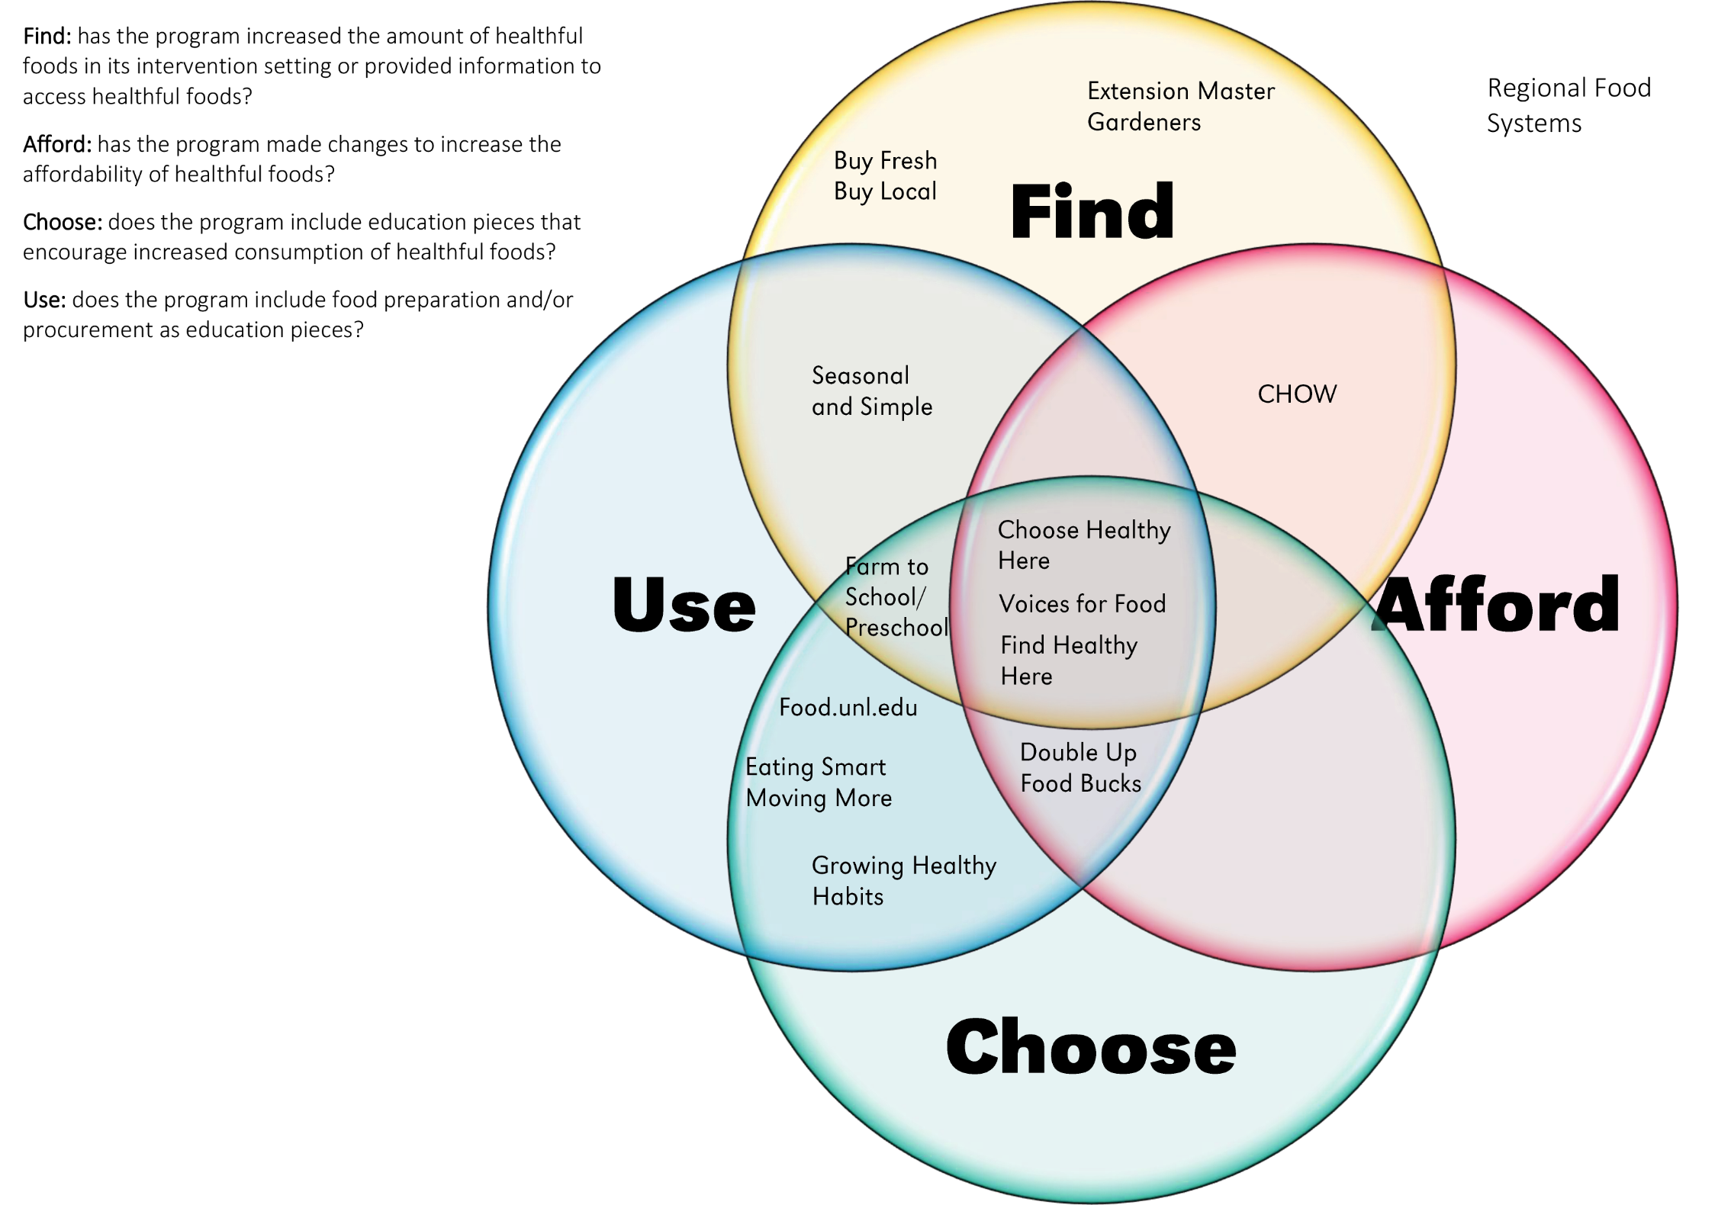
Examples of Programmatic Efforts
Community Needs Assessments: An interdisciplinary Nebraska Extension team developed a Health Needs Assessment based on what contributes to healthful communities. The Assessment helps communities voice their health needs and concerns that we use to determine programming type needed and how Extension can connect with the community to enhance program success. This assessment includes a quantitative survey as well as a qualitative discussion through facilitation.
Nebraska Double Up Food Bucks Program: An incentive program intended to increase the purchase of fresh fruits and vegetables by Supplemental Nutrition Assistance Program (SNAP) recipients in participating locations. NE Double Up is modeled after the Fair Food Network’s successful Double Up Food Bucks program. The NE Double Up program is provided at retail outlets such as grocery stores, farmers markets, and community supported agriculture (CSA).
Choose Healthy Here Program: A healthy food retail program, which is modeled after the evidenced-based Stock Healthy, Shop Healthy Missouri program, focuses on four areas of healthy food access. Choose Healthy Here connects public health and community organizations to retailers to promote healthy foods, deliver in-store nutrition education, and increase the purchase of healthy foods by customers and the store.
Healthy Food Pantry Initiative: In partnership with Extensions at Iowa State, Purdue, and University of Wisconsin, Nebraska Extension SNAP-Ed and Master Gardeners teamed up to provide fresh produce to Nebraskans in need. Communities can apply for a chance to start, maintain, or connect to a community garden for the purpose of donation to emergency food access sites. Find Healthy Here is a complimentary program that helps food pantries through promotion, placement, and organization promote the healthy produce.
Examples of Partners, Collaborators, and Funders:
Other Issue Teams
CHI Health
Children’s Hospital
Nebraska Department of Agriculture
USDA
University of Nebraska Foundation

Slide 36
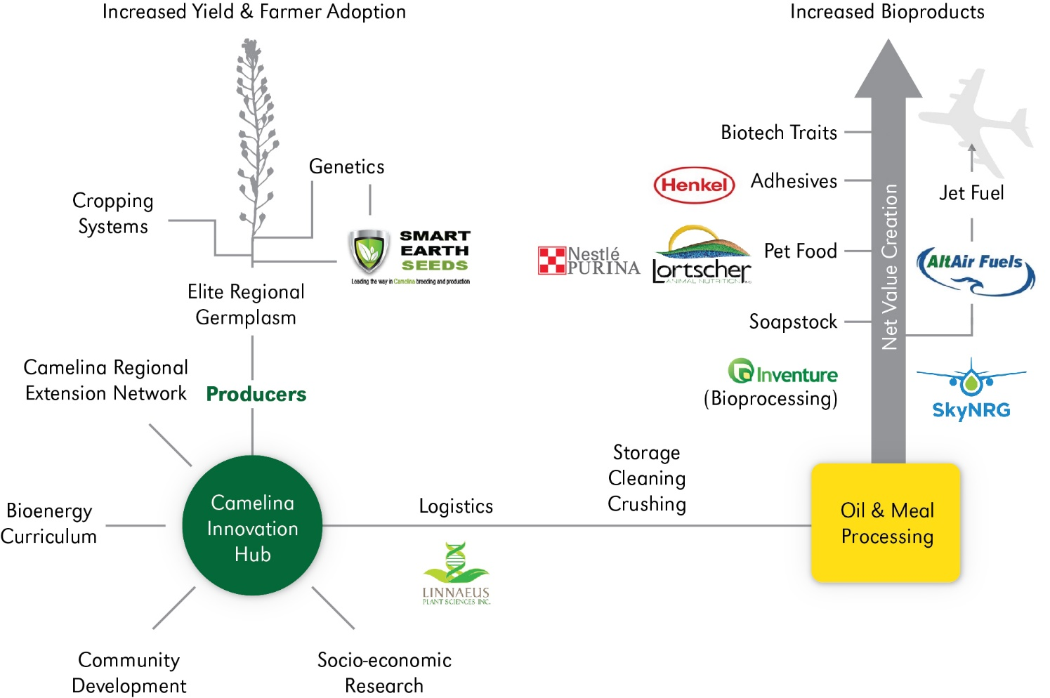
The CaRBON Solution
Increased yield value & farmer adoption
Increased co-product value

Slide 37
Camelina Innovation Hubs
Producers
Regional Extension Network
Logistics
Camelina Innovation Hubs
Bioenergy Curriculum
Community Development
Socio-economic
Research
research

Slide 39
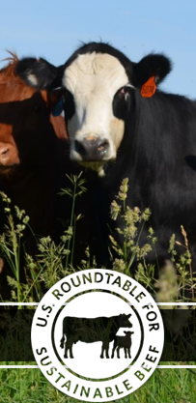
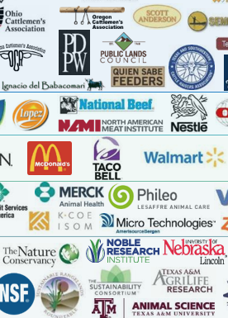
Partnering with Food Supply Chain Led Sustainability Initiatives
110 members include:
Organizations leading supply chain definition of sustainability “indicators” and “metrics” for on-farm measuring.
IANR is a member of Field to Market (commodity crops) and US Roundtable for Sustainable Beef.
130 members including grower organizations, agribusiness, Processors, retailers, civil society, and land grant universities.

Slide 40
NSF Funded A Virtual Center Enabling Graduate Student Innovations in Food, Energy, and Water
Engage graduate students in unique interdisciplinary experiences preparing them to be leaders of solutions for wicked challenges.
Dairy Carbon Cohort Challenge will be piloted in fall 2018 – partnering with NIFA Dairy CAP project and their Virtual Dairy Farm
Led by U of IL. Also includes, IA State, UC Davis, UNL, NC State, U of MN
Dairy Carbon Cohort Challenge
Overview of Educational Experiences
Dairy Carbon model illustrated in Virtual Dairy Farm
Optional:
Individual student and/or faculty projects
Optional:
Projects
Student
Products
Cohort Challenge
Dairy Carbon - Workshops
Graduate Students
High Performing Learning Communities
Toolbox Modules
Understanding Stakeholders
Communicating science
Systems Thinking and
Visual Mapping

Slide 42
2018 USDA NIFA AFRI Sustainable Agricultural Systems
Byron D. Chaves-Elizondo
Assistant Professor and Food Safety Extension Specialist
Department of Food Science and Technology
University of Nebraska-Lincoln
byron.chaves-elizondo@unl.edu

Slide 43
BACKGROUND
Expansion of the Nebraska Poultry Industry
Currently 8-10 million chickens
Expected 30+ million chickens
Costco in Fremont, NE and surrounding areas
Hatcheries, poultry houses, slaughterhouses, and other operations
Impact on animal, environmental, and socio-economical health

Slide 44
Environmental and Community Sustainability of Expanded Poultry Operations in Eastern Nebraska
Assess impact and determine risk mitigation strategies of expanding poultry operations
Animal Health and Food Safety
Environmental Health
Occupational Health
Community and Rural Development
Economic Development
Antimicrobial Resistance
Animal Waste Management
Fate of contaminants in the environment
Water Use and Management
PD/PI from Agricultural Economics or Environmental Sciences?

